Slide 1
Solar Power Forecasting with AI Driven Power Management
नेशनल इंस्टीट्यूट ऑफ इलेक्ट्रॉननक्ट््स एंड इंफॉर्मेशन टेक्नोलॉजी, चेन्नई
National Institute of Electronics and Information Technology, Chennai Autonomous Scientific Society of Ministry of Electronics & Information Technology (MeitY), Govt. of India
Project Guide
Mr. Saurav Acherjee
By Melanathoor Sai Neelesh

Slide 2
Project Objectives
To predict solar AC power generation using weather data
To analyze the effect of irradiation and cloud cover
To estimate revenue based on generated power
To develop a user-friendly dashboard using Streamlit
To implement a custom Linear Regression model
Help users decide whether to store energy in batteries or sell it to the grid.

Slide 3
Need of the project
Solar power depends on weather conditions
Power generation is not constant
Need for accurate prediction and planning
Helps in better energy usage and cost saving
Useful for smart grid and renewable systems
Using AI helps us "see the future" so we don't waste energy and can save money.

Slide 4
Scope of the work
Solar power prediction for Indian cities
Weather-based estimation using API
Revenue calculation and decision support
Dashboard visualization using Streamlit
Can be extended to multiple solar plants

Slide 5
Work Progress
 | Project Work completed
First review Project idea finalized Data collected and cleaned Custom model developed Dashboard
Second review created Testing completed Report and PPT preparation
Third review Project finished

Slide 6
INTRODUCTION
Solar energy is one of the most important renewable energy sources.
The power generated depends on weather conditions such as sunlight and cloud cover.
Machine learning can be used to predict solar power output.
This project focuses on building a simple and practical system for solar power forecasting and energy management.
Python & Streamlit: The tools used to write the code and build the visual dashboard.

Slide 7
Literature survey
S.No | Title of the Journal | Year | Technology | Insights
1. | Solar Power Prediction using Linear Regression | 2020 | Linear Regression | A simple method used to predict solar power using past data.
2. | Solar Energy Forecasting using Random Forest | 2021 | Random Forest | Gives better results when weather conditions change often
3. | Solar Irradiance Prediction using Neural Network | 2022 | Neural Network | Useful for studying large data and finding hidden patterns.
4. | Smart Solar Energy Management System | 2023 | Machine Learning | Helps in proper use of energy and better planning.

Slide 8
Block diagram
Weather Data/City Input
Data loader Module
Power prediction output
Custom Linear Regression
Revenue & Energy Decision
Streamlit Dashboard
Solar Power forecasting with AI driven Energy Management

Slide 9
Proposed metholodgy
Data Collection
Data Pre processing
City/weather report
Model Training
Power Prediction
Revenue Calculation
Dashboard Output
Decision Support
30-04-2026
9
Solar Power forecasting with AI driven Energy Management

Slide 10
Algorithm
Load dataset
Remove missing values
Train model using irradiation and power
Take user input (city/weather)
Predict solar power
Calculate revenue
Display results

Slide 11
Pseudocode
Start
Load data
Train model
Select city
Get weather data
Predict power
Calculate revenue
Display output
End

Slide 12
Result Analysis
System predicts solar power successfully
Higher irradiation gives higher output
Cloud cover reduces power generation
Dashboard shows results clearly
Revenue estimation is generated

Slide 13
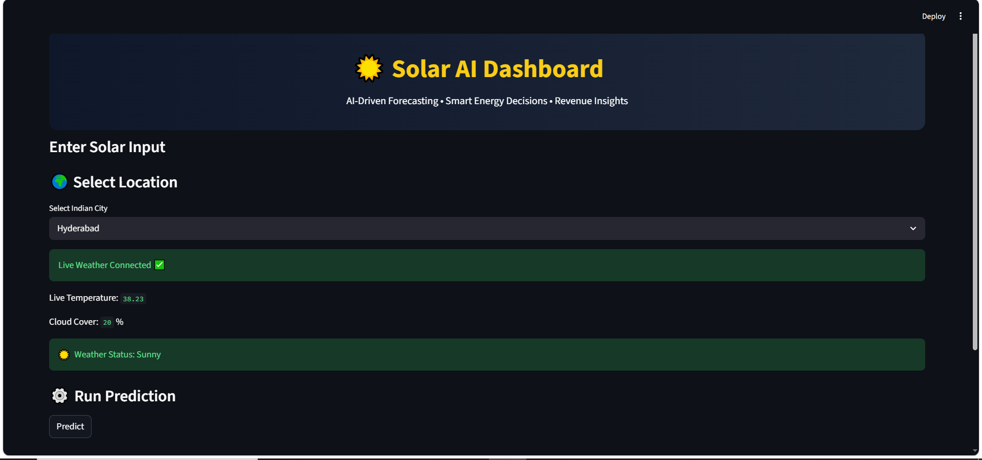
Result Analysis

Slide 14
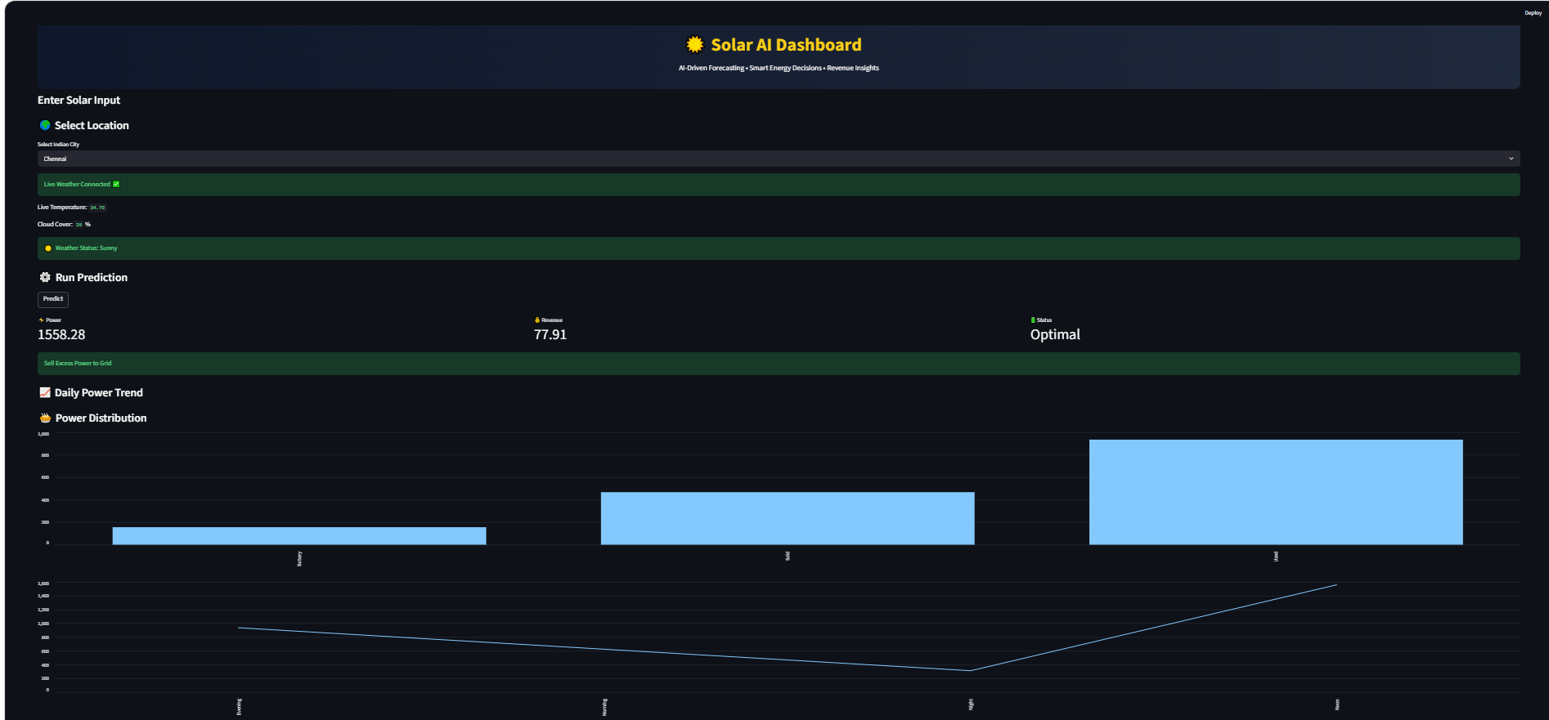
Result Analysis

Slide 15
INFERENCE
Weather plays important role in solar power
Model gives logical predictions
Dashboard helps in understanding results
System can support energy planning
Solar Power forecasting with AI driven Energy Management

Slide 16
SUMMARY
Solar power prediction system developed
Custom Linear Regression used
Dashboard created using Streamlit
Results are simple and useful
Project completed successfully

Slide 17
References
Python Software Foundation, Python Documentation. Available at: https://docs.python.org/
Streamlit Inc., Streamlit Documentation. Available at: https://docs.streamlit.io/
Pandas Development Team, Pandas Documentation. Available at: https://pandas.pydata.org/docs/
NumPy Developers, NumPy Documentation. Available at: https://numpy.org/doc/
OpenWeather, Weather API Documentation. Available at: https://openweathermap.org/api
Kaggle, Solar Power Generation Dataset. Available at: https://www.kaggle.com/
National Institute of Electronics and Information Technology (NIELIT), Chennai, Course Materials and Project Guidelines.
Microsoft, Visual Studio Code Documentation. Available at: https://code.visualstudio.com/docs
GitHub, GitHub Documentation. Available at: https://docs.github.com/

Slide 18
Acknowledgement
I would like to thank my project guide Mr. Saurav Acherjee and institution for their support and guidance in completing this project successfully.

Slide 19
Thank You

